Slide 1
Project One: Investigating the Impact of Metals on Cardiovascular Disease: A Case Study
aVA Tahmasebi Marie nasara Pietro stolf
Rana Mousavi Ritta Shaheen Robert osei dwomoh
Wayne williams

Slide 2
Key Questions
The Hidden Dangers of Metals:
Can They Contribute to Cardiovascular Disease?
Beyond Cholesterol:
Uncovering the Strongest Indicators of Cardiovascular Disease in Blood Tests

Slide 3
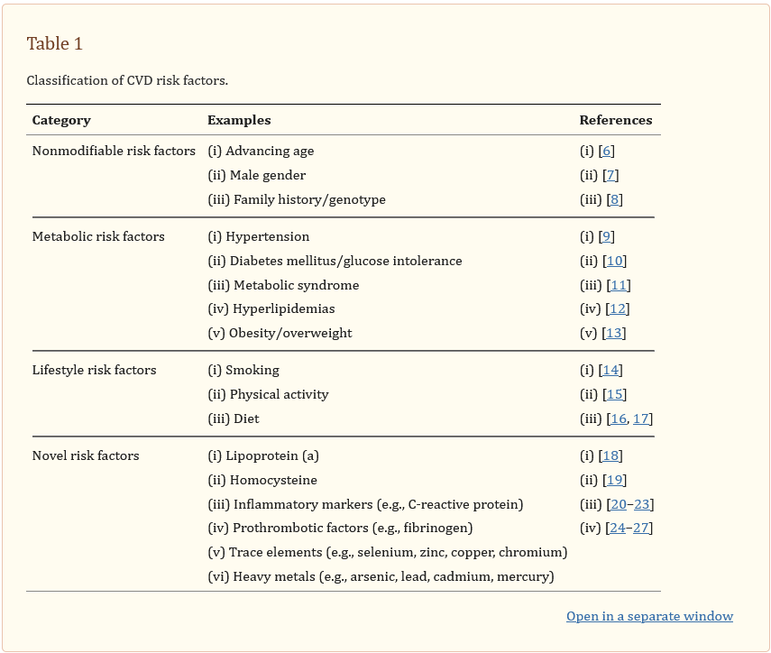
Heavy Metal Poisoning
and
Cardiovascular Disease

Slide 4
Dataset - National Health and Nutrition Examination Survey (NHANES) (2013-2014)
The dataset features well-documented heavy metal levels for each participant, specifically: - Lead - Cadmium - Selenium - Manganese - Mercury
The dataset also features lipid levels, specifically: - HDL Cholesterol (good) - LDL Cholesterol (bad) - Triglycerides

Slide 5
Source Material
Heavy Metal Poisoning and Cardiovascular Disease (National Library of Medicine) [Published: September 8, 2011]
https://www.ncbi.nlm.nih.gov/pmc/articles/PMC3168898/
National Health and Nutrition Examination Survey (NHANES Datasets) [Surveyed: 2013-2014]
https://www.kaggle.com/datasets/cdc/national-health-and-nutrition-examination-survey
Environmental Toxic Metal Contaminants and Risk of Cardiovascular Disease [Published: August 29, 2018]
https://www.bmj.com/content/362/bmj.k3310
Metal biomarker mixtures and blood pressure in the United States [Published: February 14, 2021]
https://www.ncbi.nlm.nih.gov/pmc/articles/PMC7883578/
National Library of Medicine (API)
https://www.ncbi.nlm.nih.gov/

Slide 6
Project Premise
The purpose of this project is to investigate whether the presence of heavy metals in the body have a direct contribution to cardiovascular diseases.

Slide 7
Analytical Process
Collect Data
Clean and Preprocess Data
Analyze Data
Interpret Results
Communicate Findings

Slide 8
First Analysis
Clean the data
Create Data Frame
Heat Map

Slide 9
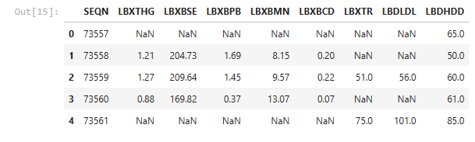

Slide 10
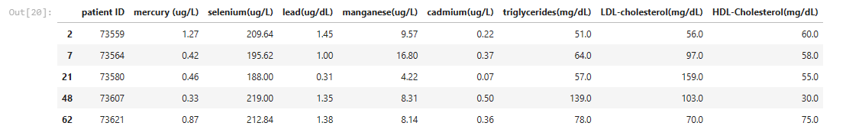

Slide 11
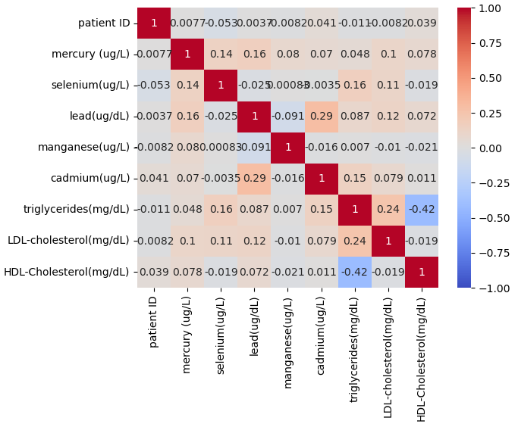
HEATMAP 1

Slide 12
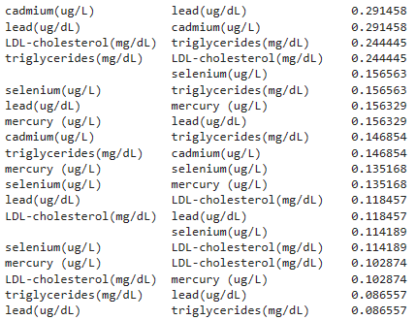

Slide 13
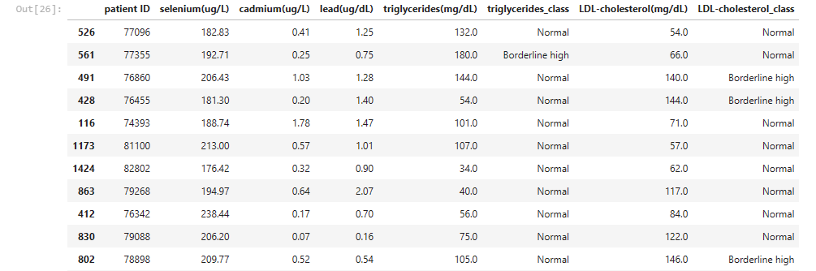
Data Comparison to Medical Norms

Slide 14
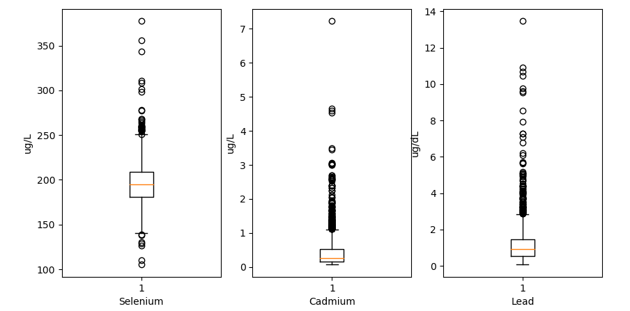
Quartiles of Heavy Metals

Slide 15
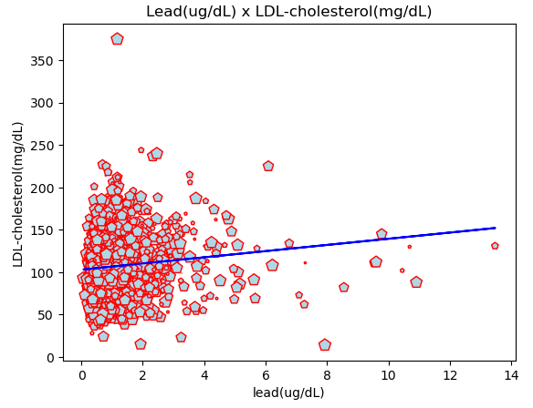
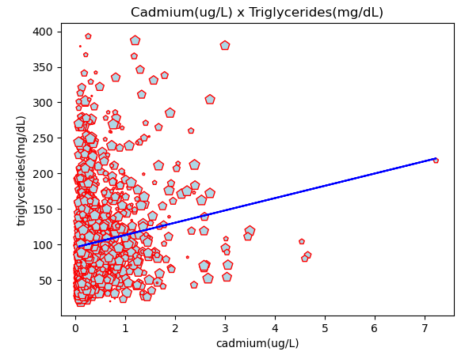
Searching For Correlations

Slide 16
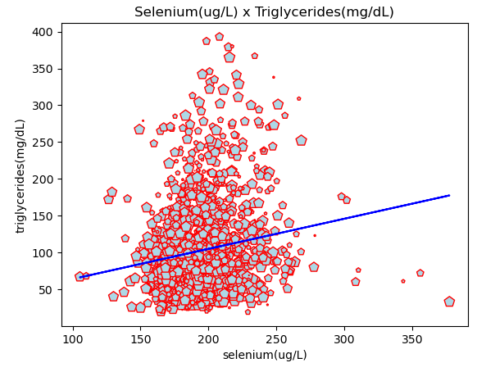
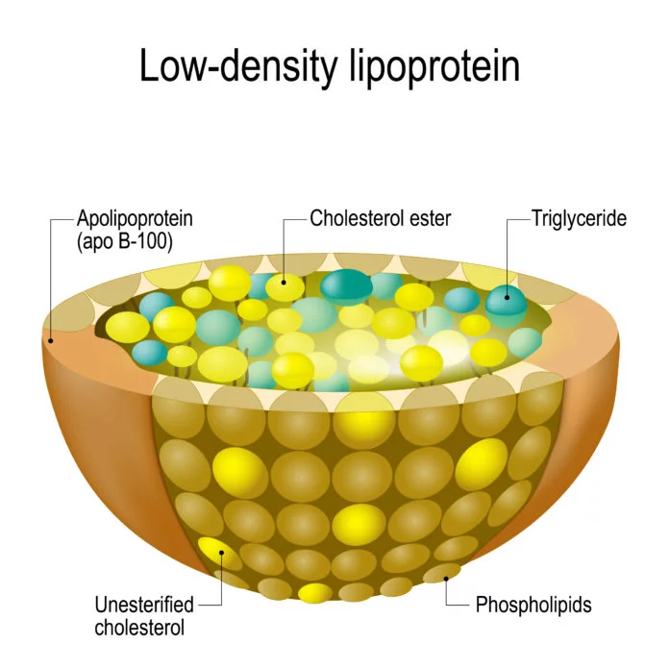
Searching For Correlations

Slide 17
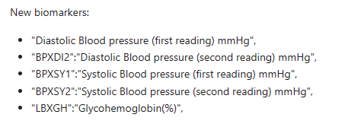
Observations

Slide 18
Adding New Data

Slide 19
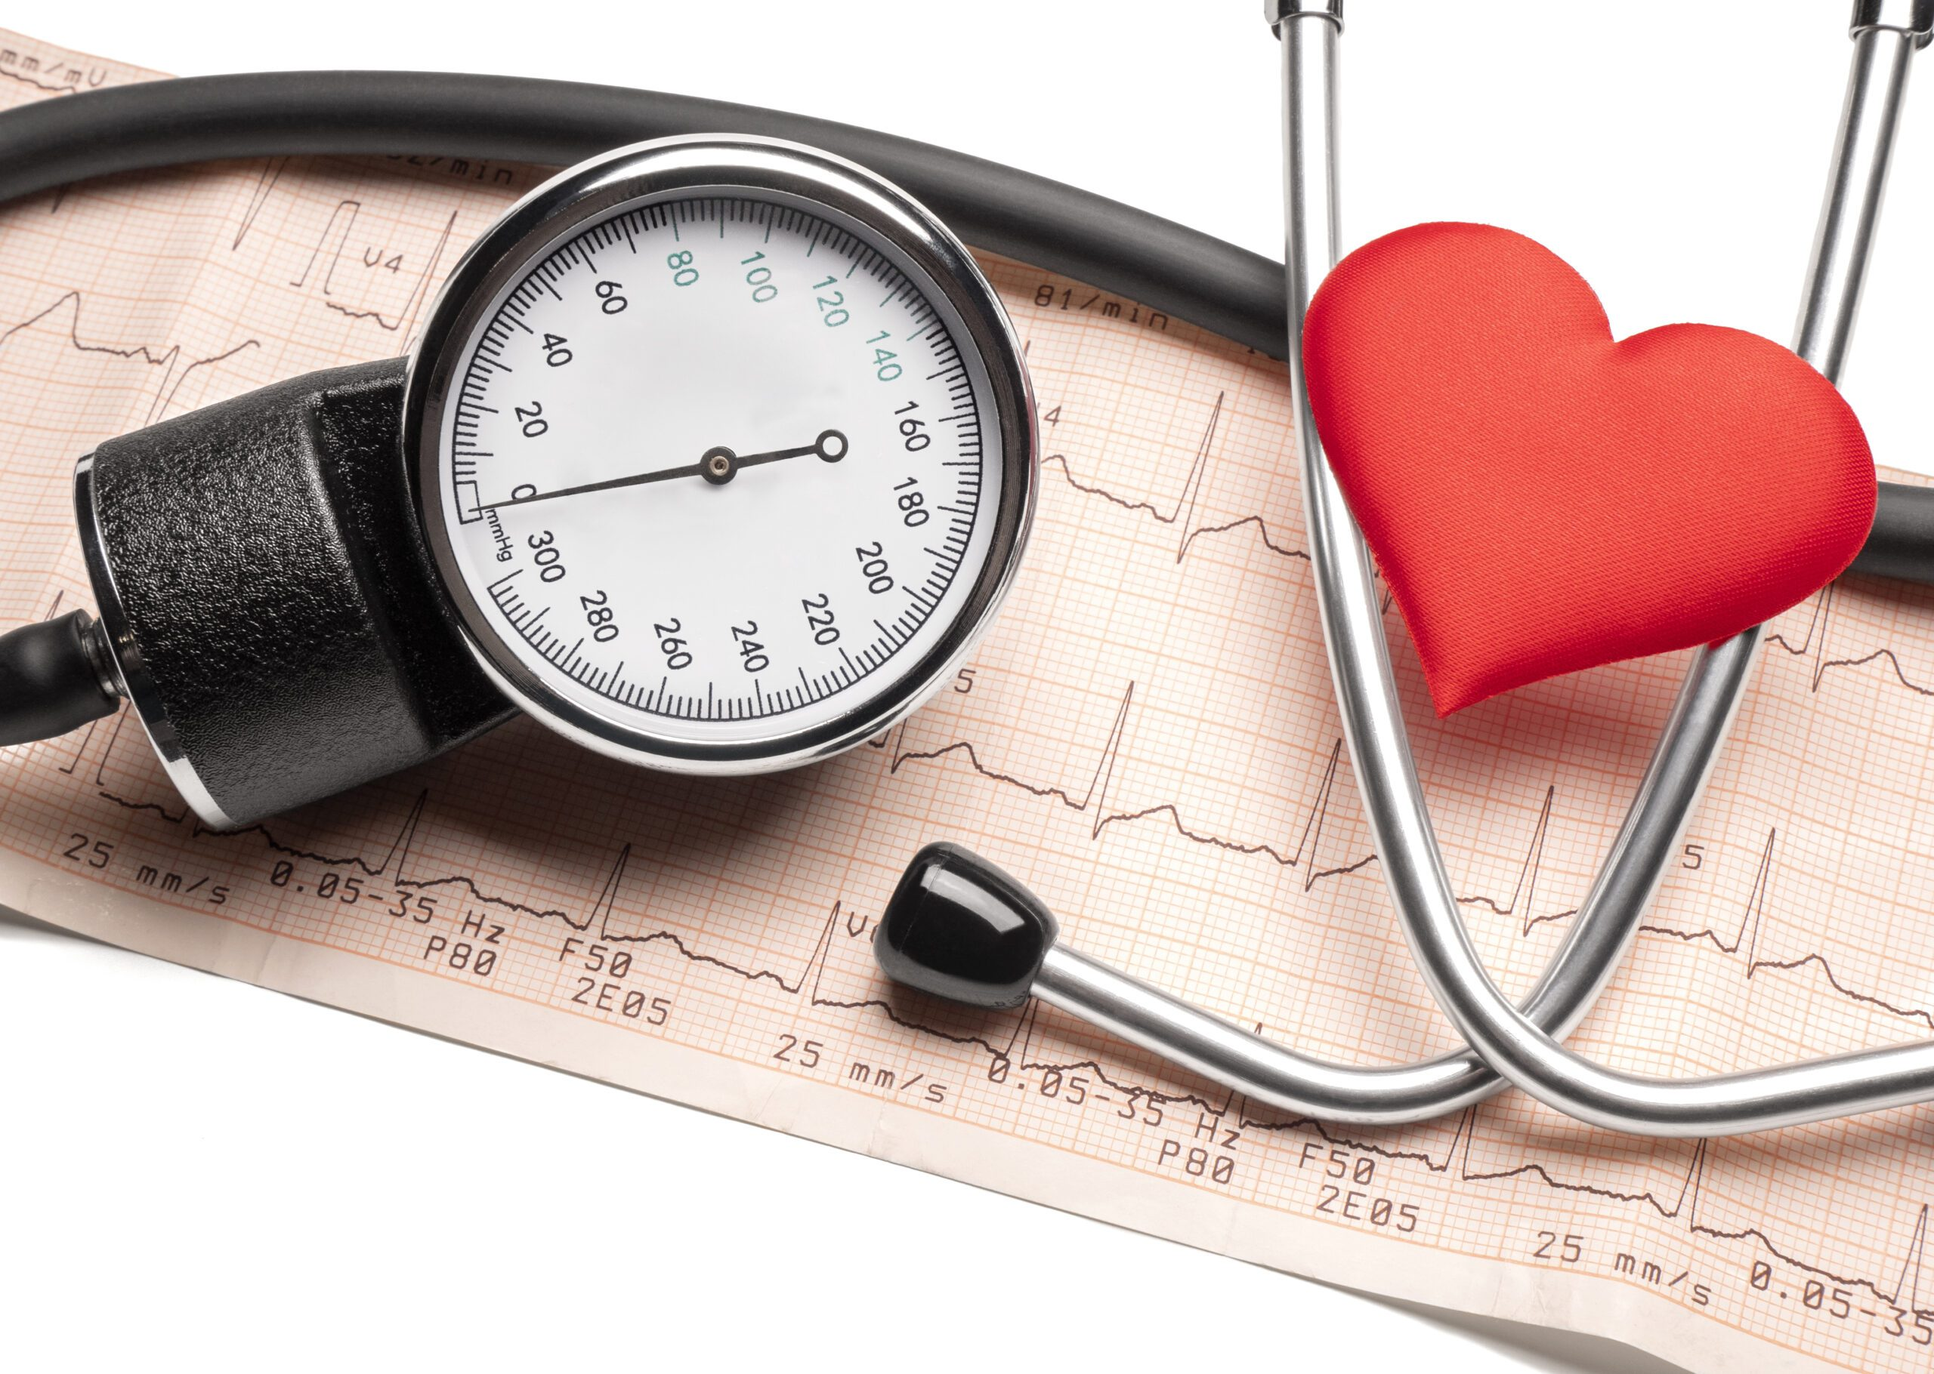
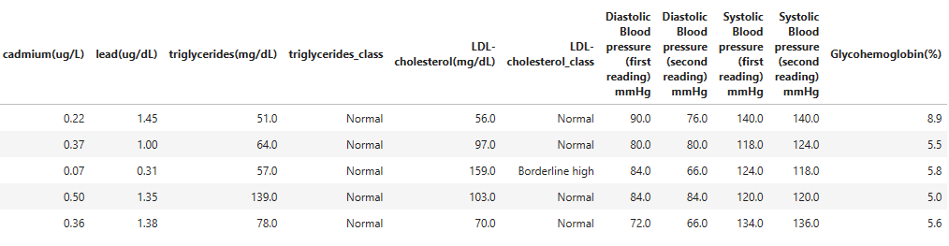

Slide 20
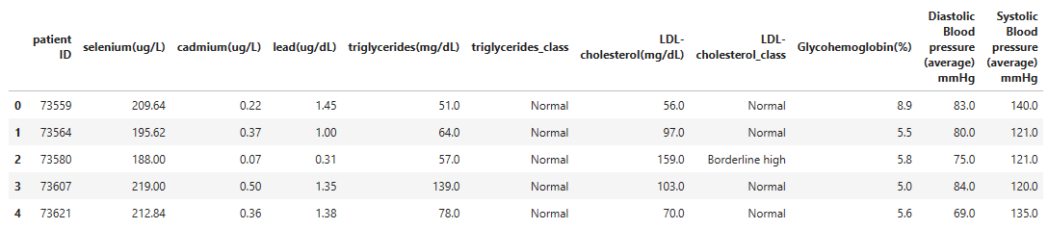

Slide 21
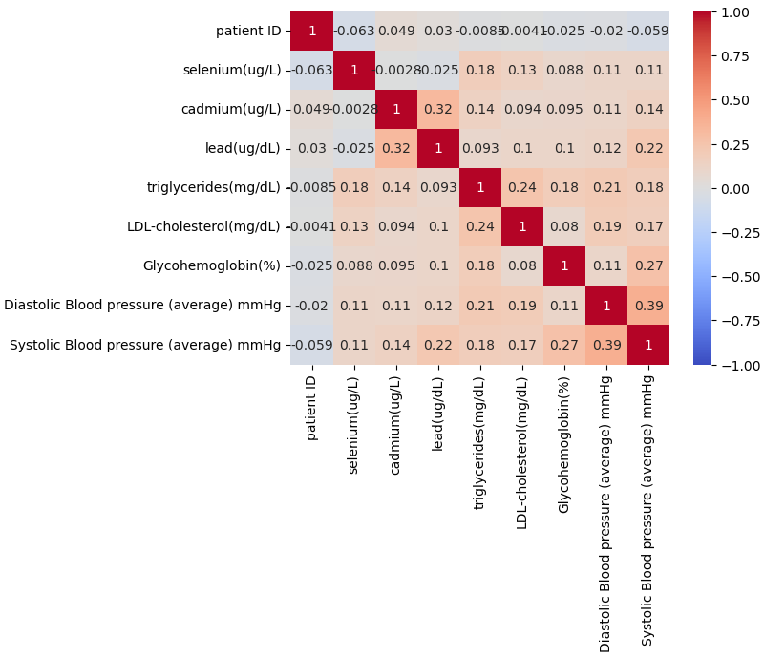
Heat Map 2

Slide 22
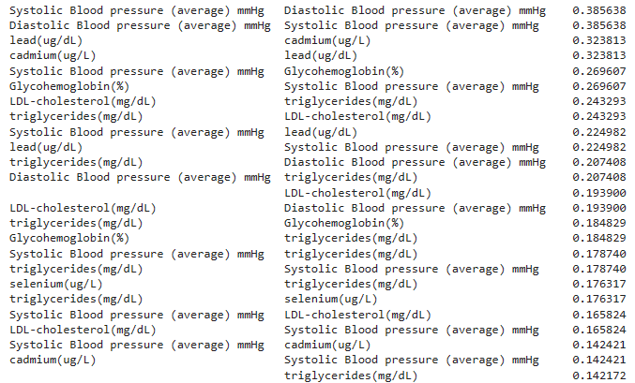

Slide 23
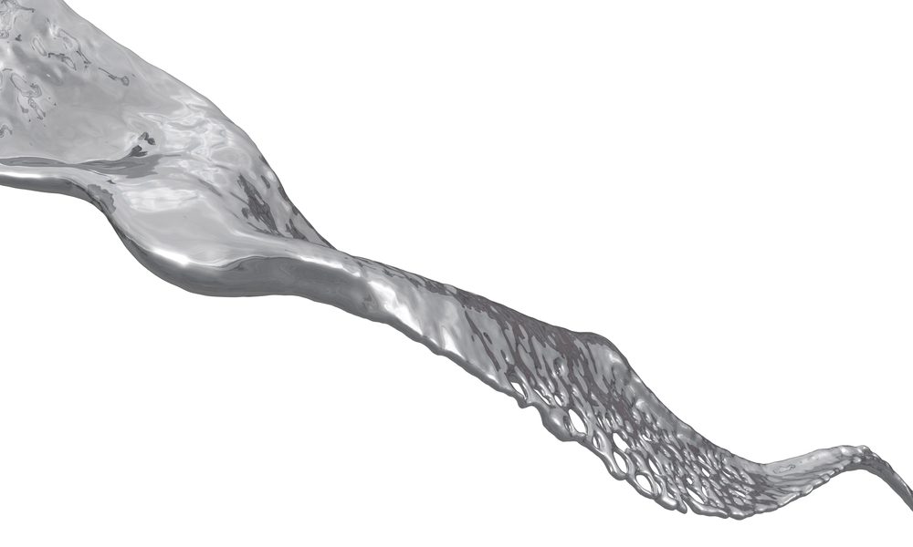
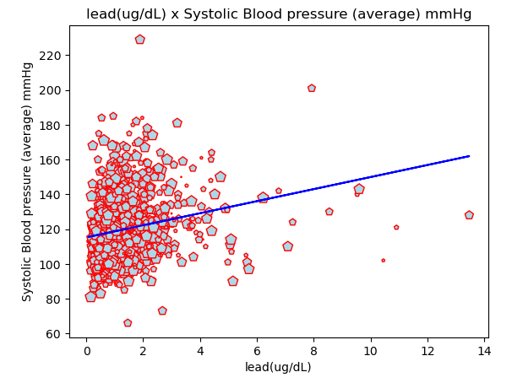

Slide 24
Future API Research

Slide 25
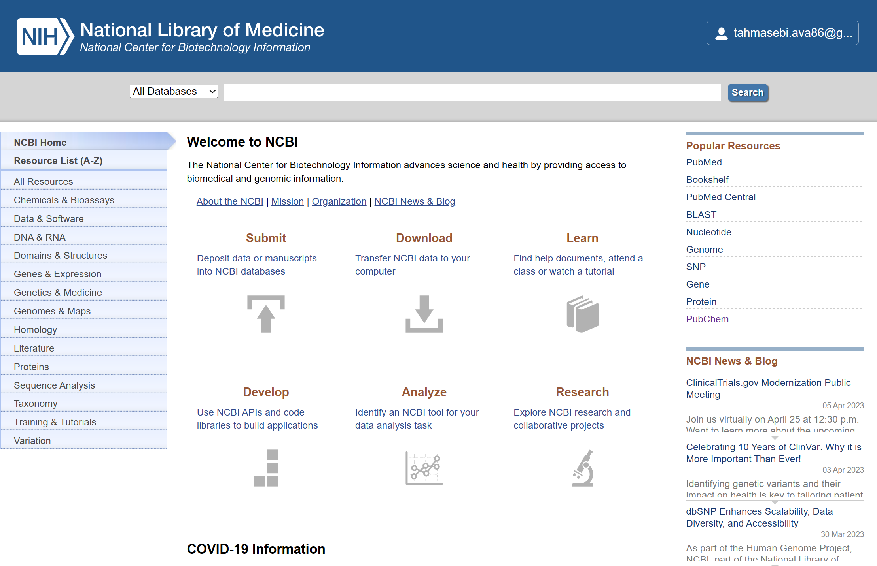

Slide 26
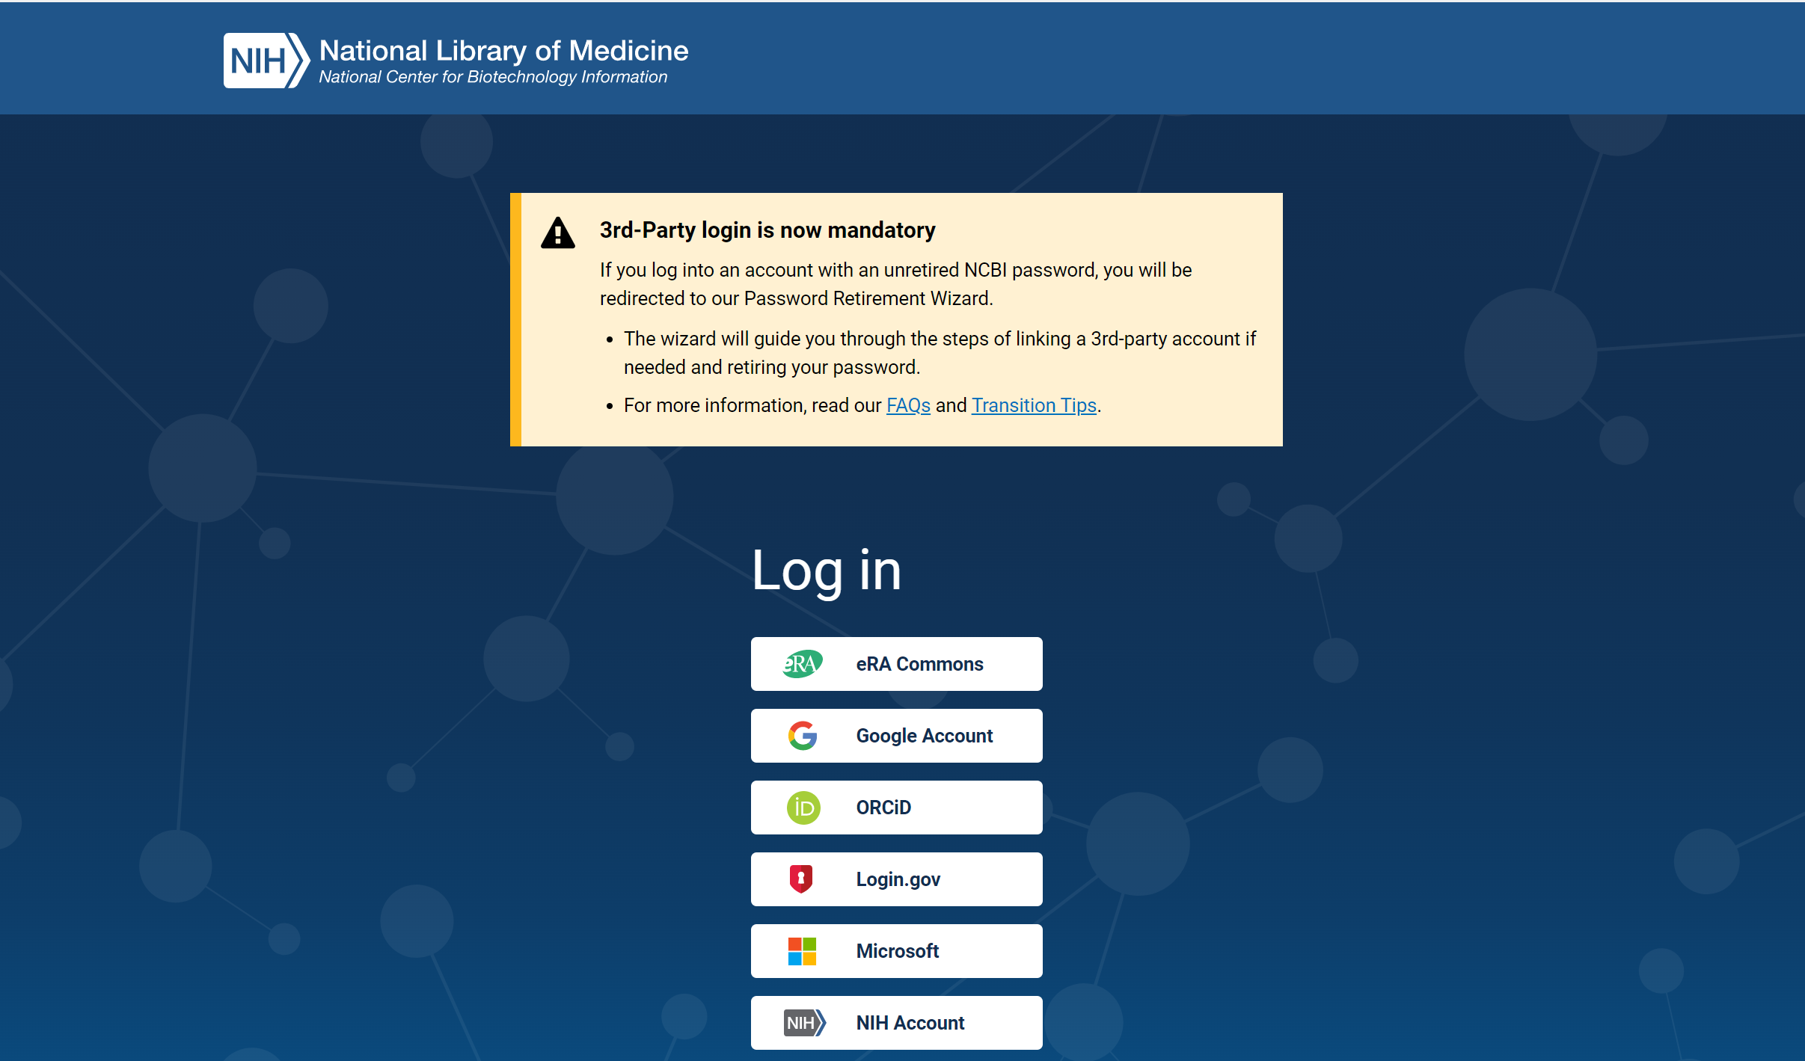

Slide 27
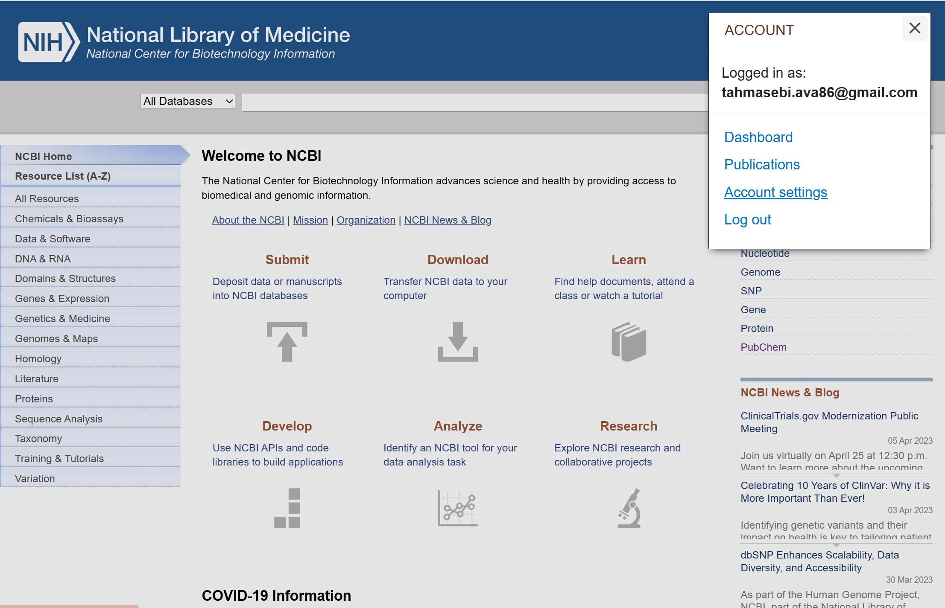

Slide 28
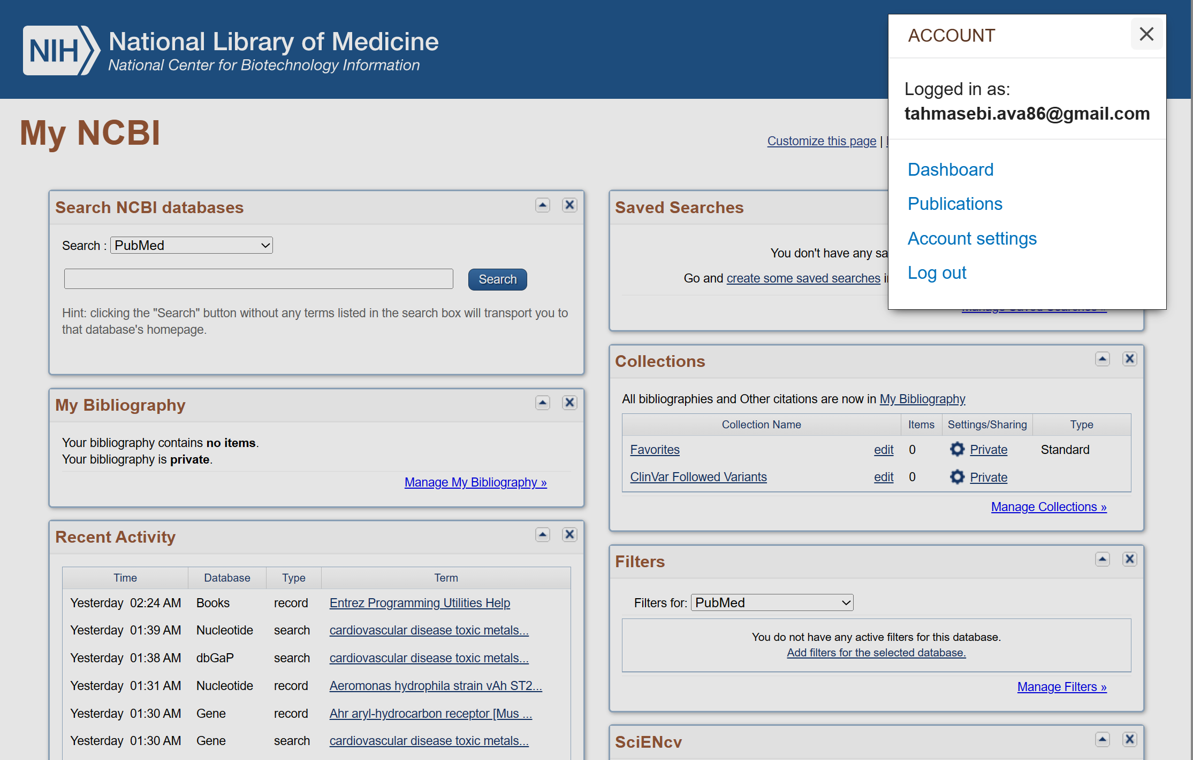

Slide 29
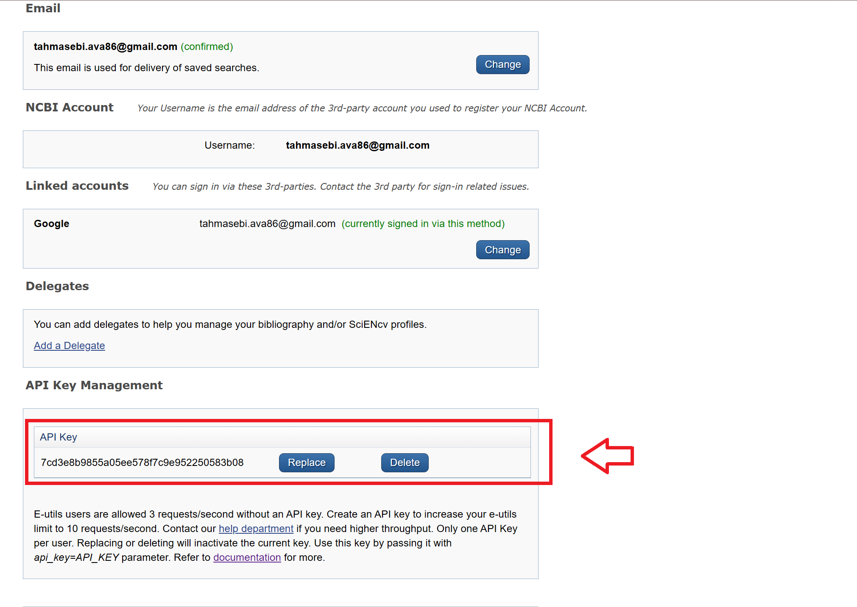

Slide 30



Slide 31
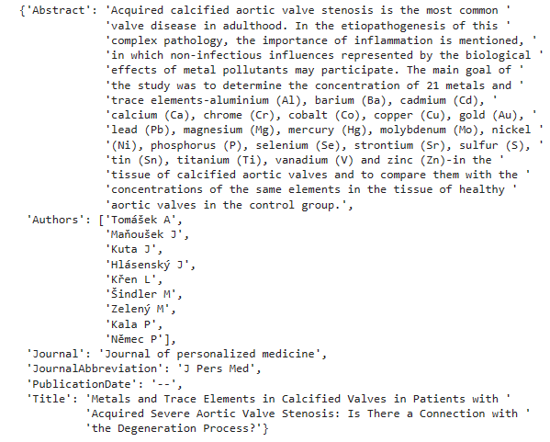

Slide 32
Analysis and Conclusion
Heavy metals such as mercury, lead, and cadmium are detrimental to health and increase the risk of heart disease.
Essential minerals like selenium and manganese promote heart health by boosting HDL cholesterol levels.
No strong correlation found between HDL/LDL and metals
Additional cardiovascular measurements are required to obtain accurate results
C-reactive protein (CRP) can provide valuable insights into heart disease risk by indicating inflammation.
In the future, we will incorporate urinary tests to more accurately measure exposure to metals, with a focus on detecting lead and mercury.
Taking proactive steps to monitor heavy metal exposure, mineral intake, and inflammation can minimize the risk of heart disease and lead to a healthier life.

